Slide 1
GCBASIC
PIC16Fxxxx chip Family ( Legacy )
Part 13 - Using a SPI GLCD display solutions

Slide 2
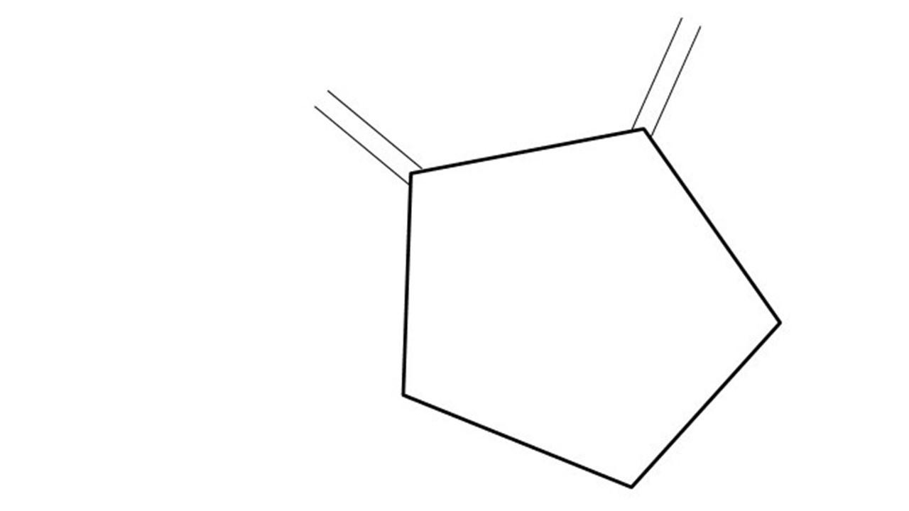
GCBASIC
PIC16Fxxxx chip Family ( Legacy )
Part 13 - Using a SPI GLCD display solutions
January 2025

Slide 3
GCBASIC
Like and subscribe!

Slide 4
PIC16Fxxxx
PIC16Fxxxx is a high performance PIC16
Digital and Analog peripherals
8 –bit or 10-bit ADC
Multiple communication interfaces
Serial, I2C and SPI
PWM – CCP/PWM and 16Bit
The PIC16 offers 8, 14,18,20, 28, 40 and 48-pin packages to support customers in a wide variety of applications.

Slide 5
Videos...
Install the hardware and make the board work – make LEDs work
Make four LEDs flash in a sequence
Set the LEDs to represent the value of ADC
Sequence the LEDs with a delay using the value of ADC
Using an input to set the state of the LEDs
Using the reset switch
Using the switch, ADC – make the LEDs flash in a sequence with reverse
Using the serial to display values
Using the timer0 overflow, 8bit timer, 16bit timer to flash the LEDs
Using EEProm – showing values on the serial terminal, and more constants insights
Using I2C with serial to discover I2C devices
Using an I2C GCLD display
Using a SPI GCLD display
Using PWM, many ways, to dim the LEDS
Using an external interrupt to control an LED
Using storage within the chip – Progmem, EEPROM and DATA blocks
The GCBASIC tool chain
Assembly , alternatives assemblers and MPLAB-X
Summary

Slide 6
GCBASIC Compiler
GCBASIC Compiler
GCBASIC is an Open Source compiler for PIC, AVR and LGT microcontrollers
GCBASIC supports the 16Fxxxx chip family

Slide 7
Prerequisites
Assumes you have
Installed the GCBASIC software
Installed your programmer software
Test that you have the PIC attached
You have the 4 LEDs operating
You have a POT connected
You have switches connected
You have USB/TTL serial converter
You have LCD
You have a SPI SSD1331 GLCD

Slide 8
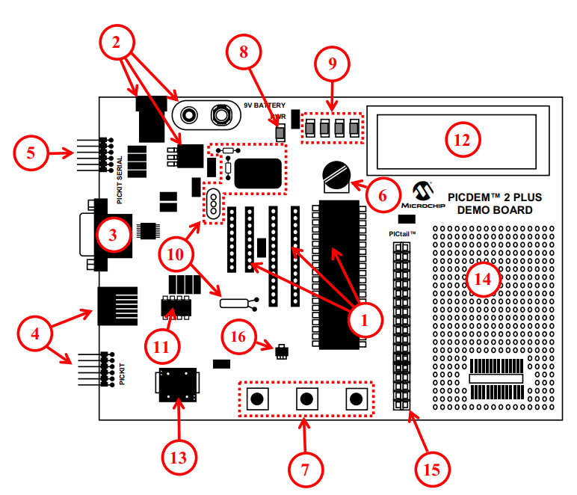
Hardware
The PICDEM 2 Plus Demonstration Board
18-, 28- and 40-pin DIP sockets (although three sockets are provided, only one device may be used at a time)
On-board, +5V regulator for direct input from 9V, 100 mA AC/DC wall adapter or 9V battery, or hooks for a +5V, 100 mA regulated DC supply
RS-232 socket and associated hardware for direct connection to an RS-232 interface
Programmer/debugger connectivity supporting MPLAB® ICD 3, MPLAB REAL ICE, PICkit 2 and PICkit 3
PICkit Serial Connector for analysis of serial communications peripherals such as SPI or I2C™
5 k pot for devices with analog inputs
Three push button switches for external stimulus and Reset
Power-on indicator LED
Four LEDs connected to PORTB
On-board external oscillators including: a) Unpopulated DIP socket for canned crystal oscillator (Y2) b) RC oscillator circuit (R4, C3) c) Unpopulated holes for crystal connection (Y1) d) 32.768 kHz crystal for Timer1 clock operation (Y3)
32K x 8 Serial EEPROM
LCD display
Piezo buzzer
Prototype area for user hardware
Expansion Header for PICtail™ daughter card connectivity or user access to
MCUs
Microchip TC74 thermal sensor

Slide 9
Hardware
Hardware
------------PORTA---------------
Bit#: -7---6---5---4---3---2---1---0---
IO: ------------SW2-------------ADC--
IO: ---------------------------------
------------PORTB----------------
Bit#: -7---6---5---4---3---2---1---0---
IO: ----------------LED-LED-LED-LED--
IO: ---------------------------------
------------PORTC----------------
Bit#: -7---6---5---4---3---2---1---0---
IO: ----TX--SDO-----SCK-RST--CS--DC—
IO: ---------------------------------
------------PORTD----------------
Bit#: -7---6---5---4---3---2---1---0---
IO: -PWR-EN--RW--RS--DB7-DB6-DB5-DB4-
IO: ---------------------------------
------------PORTE----------------
Bit#: -7---6---5---4---3---2---1---0---
IO: ----------------RST---------------
IO: ---------------------------------
Prototype Board
Power 5v0
Programmer
LEDs & resistors
Switches
TTL/USB
GLCD
SPI device and circuit

Slide 10
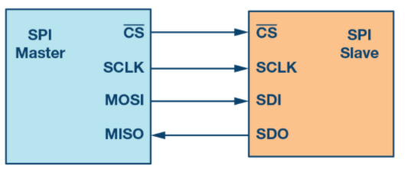
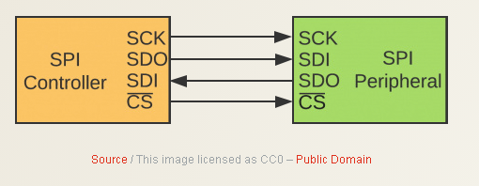
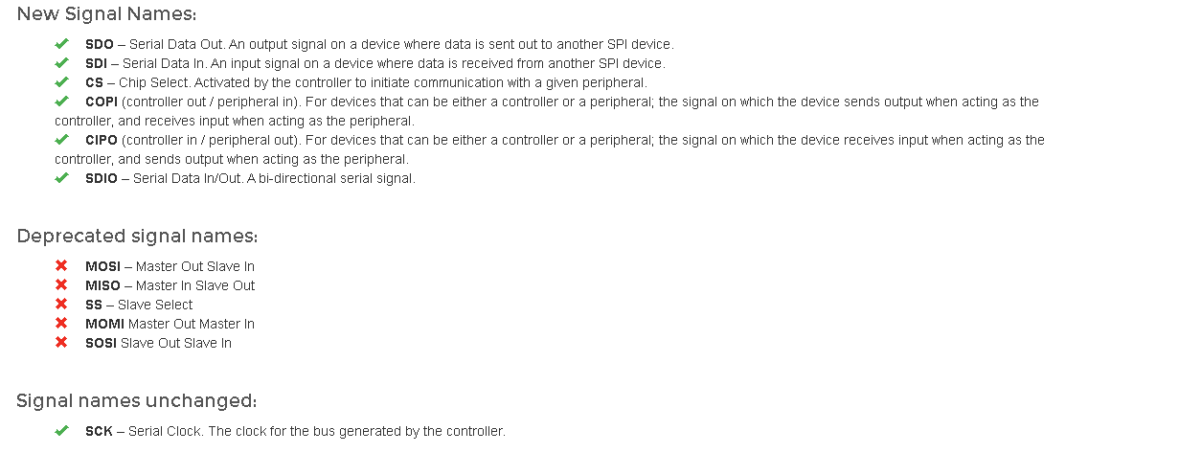
SPI
Serial Peripheral Interface (SPI) is an interface bus commonly used to send data between microcontrollers and small peripherals such as GLCD, shift registers, sensors, and SD cards.
It uses separate clock and data lines, along with a select line to choose the device you wish to control.

Slide 11
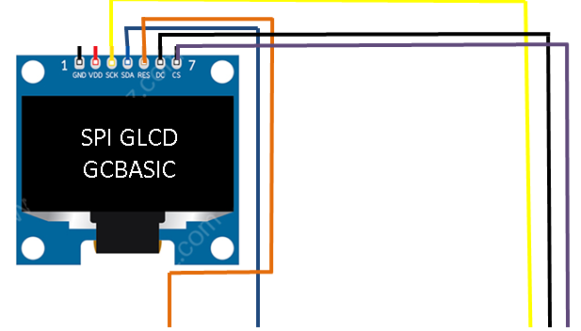
Setup - Circuit

Slide 12
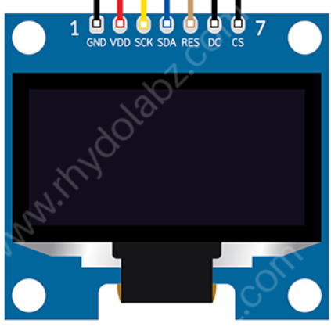
Setup - Program
SPI GLCD
GCBASIC
DATA
This is a NOT a PPS chip, so, NO need for PPS
#DEFINE GLCD_DO portC.5
#DEFINE GLCD_SCK portC.3
'Pin mappings for GCLD
#DEFINE GLCD_DC portC.0
#DEFINE GLCD_CS portC.1
#DEFINE GLCD_RESET portC.2

Slide 13
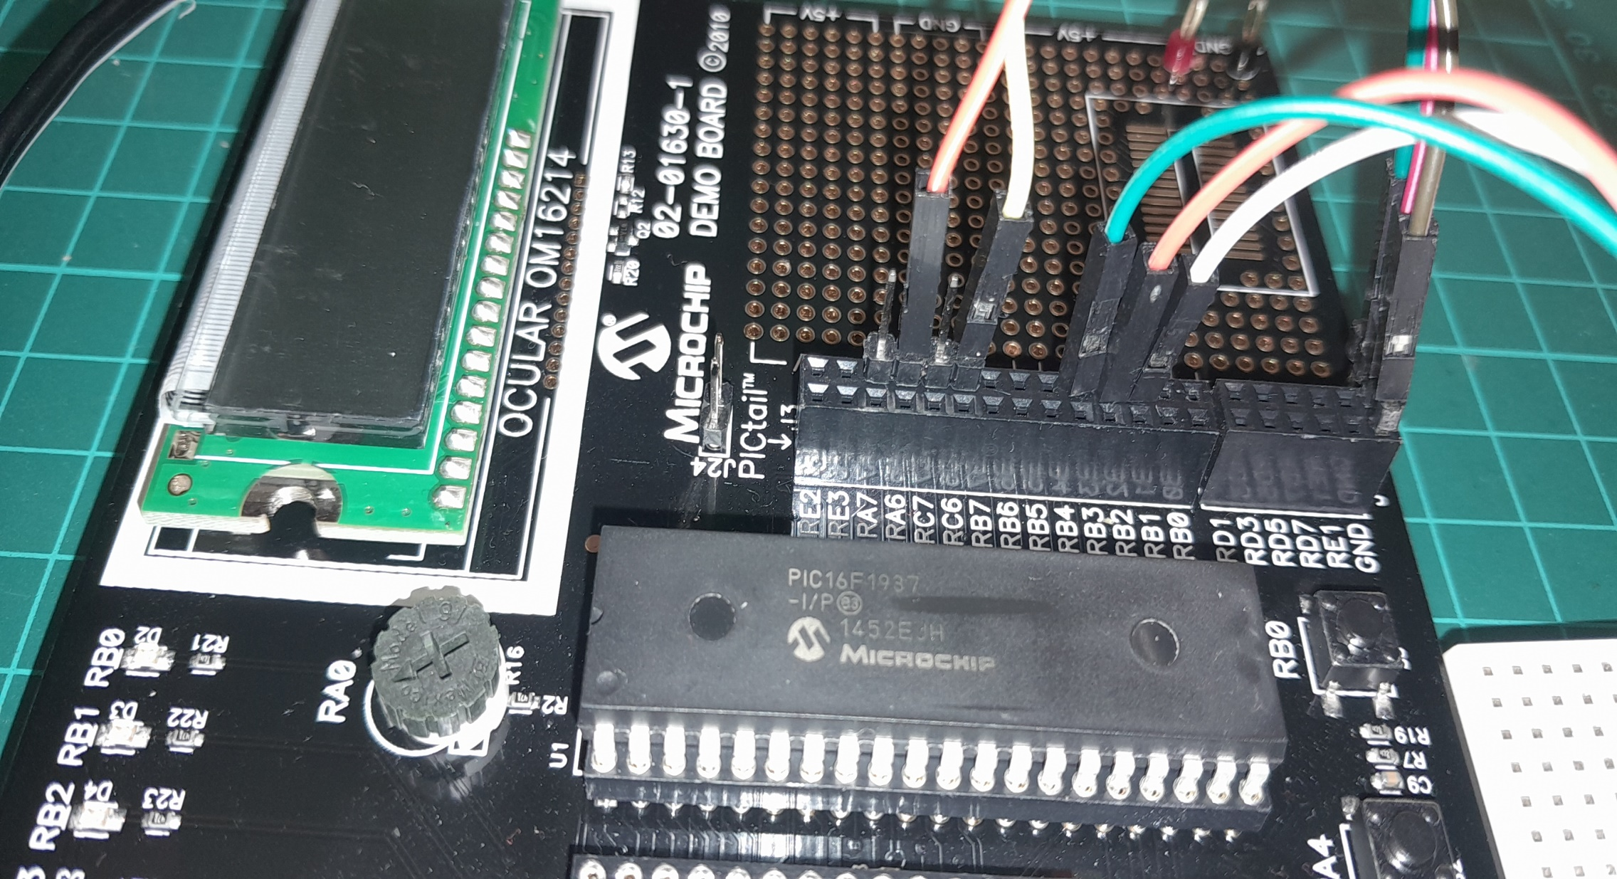

Slide 14
Setup – when things do not work ..
Things do not always work
The more connections the more trouble
Things we know
The GLCD demonstration works
Therefore is not likely to be the libraries but … work through the checklist first
Checklist
Check your connections, twice
Write a program to pulse a signal on each line, each line on at a time
Always use the software SPI first to prove connectivity

Slide 16
Lab
Review setup and operation of a SPI GLCD
Software SPI – bit banging
Harware SPI
Conditional compilation

Slide 17
Videos...
Install the hardware and make the board work – make LEDs work
Make four LEDs flash in a sequence
Set the LEDs to represent the value of ADC
Sequence the LEDs with a delay using the value of ADC
Using an input to set the state of the LEDs
Using the reset switch
Using the switch, ADC – make the LEDs flash in a sequence with reverse
Using the serial to display values
Using the timer0 overflow, 8bit timer, 16bit timer to flash the LEDs
Using EEProm – showing values on the serial terminal, and more constants insights
Using I2C with serial to discover I2C devices
Using an I2C GCLD display
Using a SPI GCLD display
Using PWM, many ways, to dim the LEDS
Using an external interrupt to control an LED
Using storage within the chip – Progmem, EEPROM and DATA blocks
The GCBASIC tool chain
Assembly , alternatives assemblers and MPLAB-X
Summary

Slide 18
GCBASIC
PIC16Fxxxx chip Family ( Legacy )
Part 13 - Using a SPI GLCD display solutions

